Slide 1
DOD SAFE
WALKTHROUGH

Slide 2
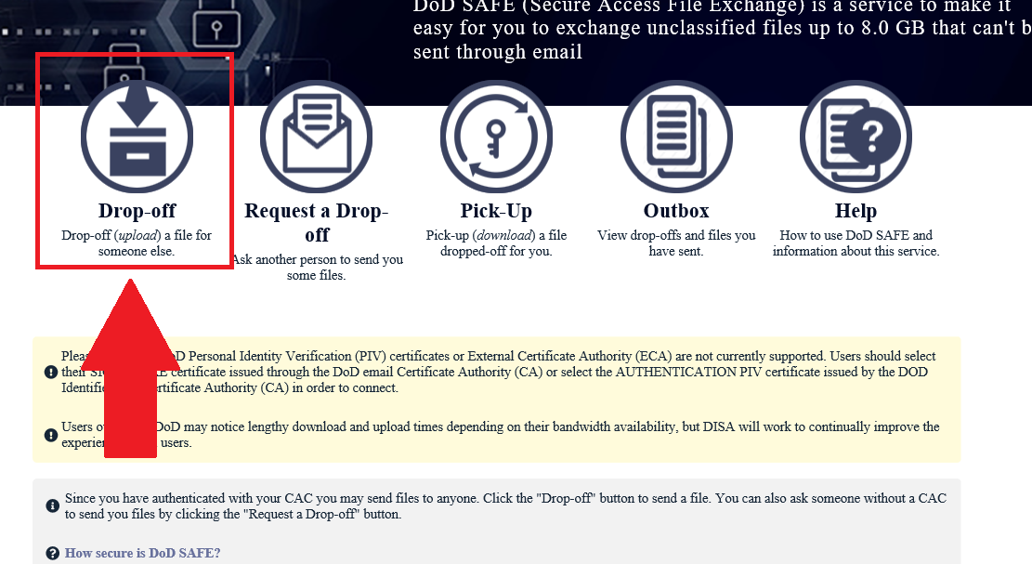
DROP-OFF & UPLOADING YOUR PACKETS
From this page, you will click “Drop-Off” as shown.

Slide 3
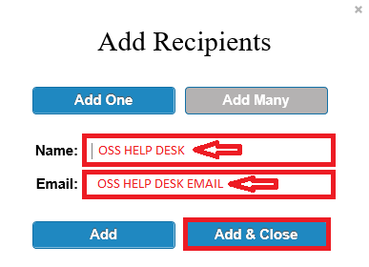
ADDING RECIPIENTS
From this page, you will add OSS Help Desk as the name of the recipient, and place the email address provided. Click Add & Close.

Slide 4
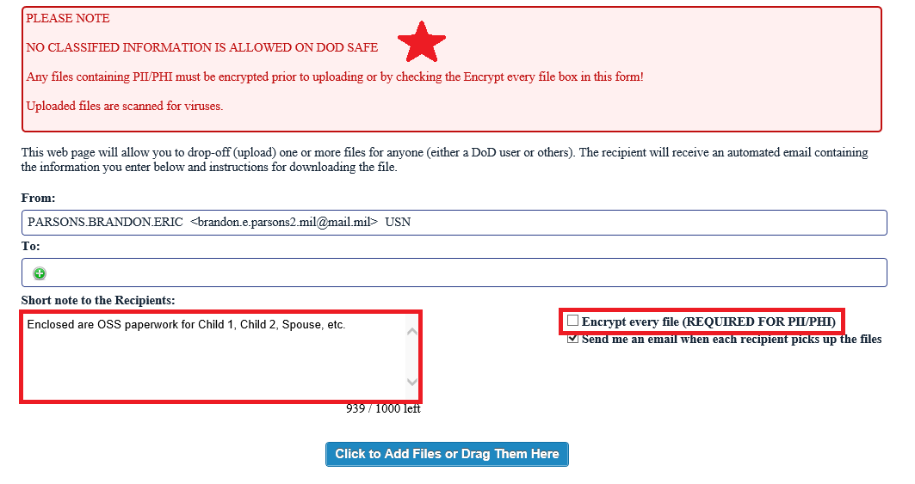
ADDING NOTES AND ENCRYPTING
From this page, you may add any pertinent information you think necessary that our staff members need to know. This section can also be used to add other contact information such as phone numbers. After your note, please click “Encrypt every file” and proceed to the next slide.

Slide 5
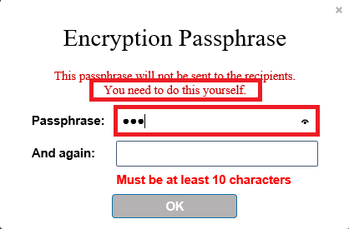
ADDING PASSPHRASE PROTECTION
From this page, you will need to add a passphrase that is at least 10 characters long. This passphrase will not be KNOWN to the recipient. The sender will need to provide the recipient with the passphrase so that we may open your attachments.

Slide 6
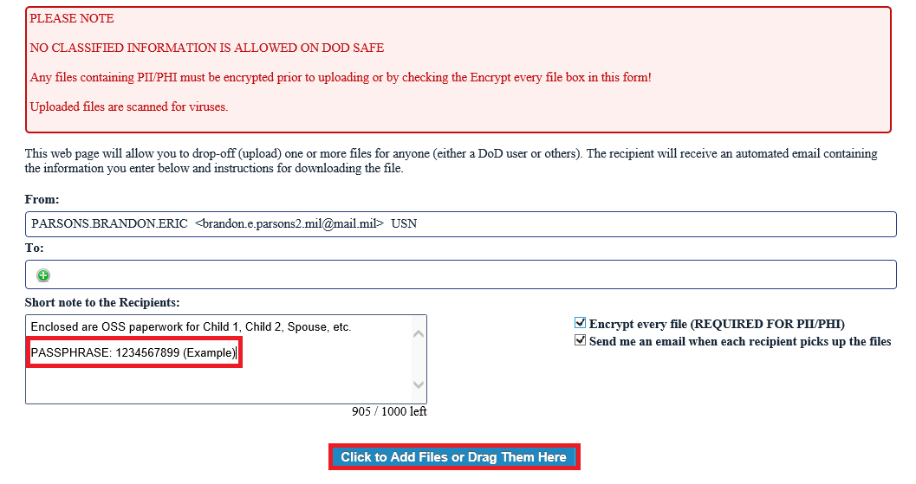
ALMOST FINISHED!
From this page, we recommend placing your passphrase into the notes section, so that the staff members receiving your encrypted message, may open the contents and provide services based on your needs. Once this completed, please click the box “Click to Add Files or Drag Them Here” and proceed to the next slide.

Slide 7
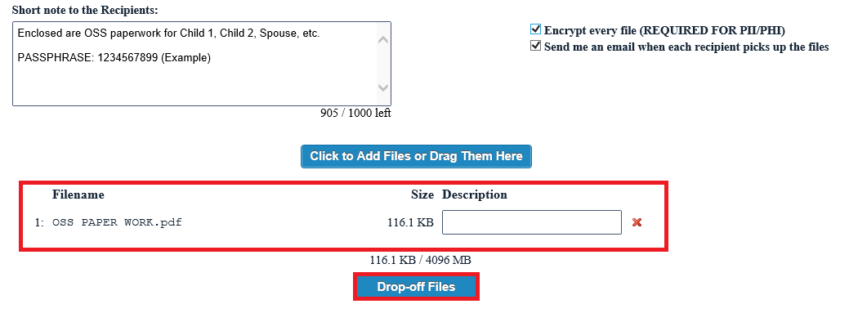
SEND IT!
From this page, you will notice your attachments listed. We kindly ask that each packet be scanned separately to reduce the chances of PII getting mixed up with other family member packets. This will reduce your screening time and allow us to maintain and organized tracking method. Once your packets are uploaded, click “Drop-off Files” and let your files get scanned and encrypted. That’s it! An email will be sent to the group, and you will receive a notification when it’s opened and completed.

Slide 8
QUESTIONS?
usn.san-diego.navmedcensanca.list.nmcsd-oss-help-desk@mail.mil

